Slide 1
Modern history of the Regulation of Sewage
DZ05
11/21/2005
Useful Source: www.epa.gov/history/publications/print/origins.htm

Slide 2
Timeline
“Ecology” not much of a public concept in the US until the end of WWII, when there was strong growth in population and suburbs
1956 Federal Water Pollution control Act
  Federal authority to curb pollution of interstate waters
Atomic Bomb, Cold War
1962 Rachel Carson, Silent Spring, Synthetic Pesticides (DDT)
Nixon 1969-1974
Your parents develop excellent taste in music and fashion

Slide 3
Timeline
June 22, 1969 Cuyahoga River Fire
  Ohio, near Cleveland, oil spill
1969 States (esp. in the Northeast) are looking for more Federal funding for their water treatment projects
1969 Congress passes the National Environmental Policy Act (NEPA)
  Recast the government role from conservator of wilderness to protector of earth, air, land, and water
  Directed President to create the Council on Environmental Quality: Russell Train was the first chairman, cabinet level
April 22, 1970 Earth Day (not long after the first Moon landings => pictures of the Blue Planet)
1970 EPA created by Nixon
  Assembled from the functions of many existing federal Departments, Bureaus, Commissions, etc.

Slide 4
Timeline
1972 “Clean Water Act”
  Amendment to the Federal Water Pollution Control Act
  Eliminate the discharge of pollutants by 1985
  National Pollution Discharge Elimination System (NPDES)
  Virtually every city in the US was required to build and operate a wastewater treatment plant
  Federal funding and technical assistance for local projects from EPA
  States had to adopt water quality standards, design plans for limiting industrial and municipal discharges, and act to protect wetlands
1980’s LOTT upgrades to secondary treatment
1987 Water Quality Act
  Regulation of toxic chemicals
  Acid rain
  Agricultural runoff
1994 LOTT upgrades to advanced nitrogen removal
Future: TMDL “Total Maximum Daily Load”
  Considers all contributions to water quality problems in a water body

Slide 5
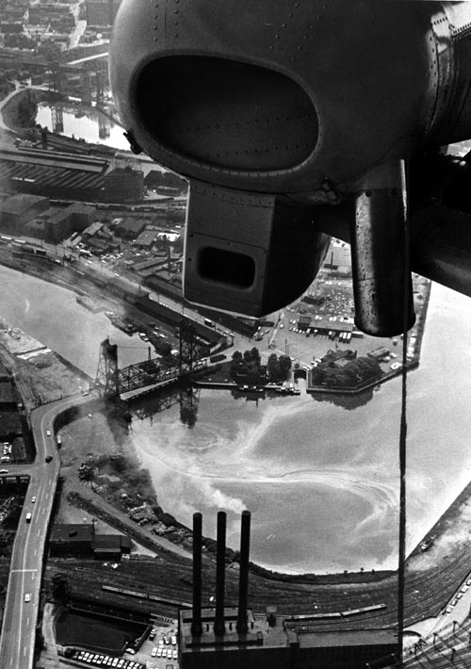
Cuyahoga River 10/18/1954

Slide 6
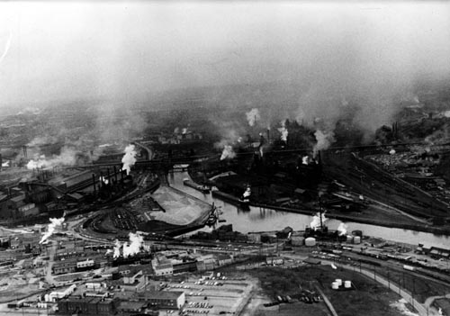
Cuyahoga 5/13/1971

Slide 7
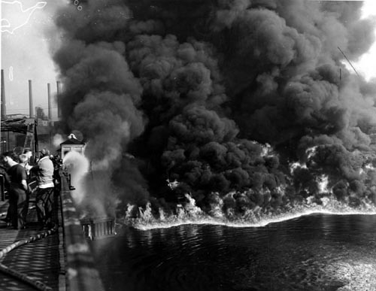
Cuyahoga on Fire 11/3/1952

Slide 8
Cuyahoga River Fire 6/22/1969
“Some river! Chocolate brown, oily, bubbling with subsurface gasses, it oozes rather than flows. ‘Anyone who falls into the Cuyahoga does not drown,’ Cleveland’s citizens joke grimly. ‘He decays.’ The Federal Water Pollution Control Administration dryly notes: ‘The lower Cuyahoga has no visible life, not even low forms such as leeches and sludge worms that usually thrive on wastes.’ It is also – literally – a fire hazard. A few weeks ago, the oil-slicked river burst into flames and burned with such intensity that two railroad bridges spanning it were nearly destroyed. ‘What a terrible reflection of our city,’ said Cleveland Mayor Carl Stokes sadly.
  August 1, 1969, Time Magazine

Slide 9
The Cuyahoga Fire becomes modern mythology
“Before the Clean Water Act, water quality in many, many parts of our country was deplorable… The Hudson River contained bacteria levels 170 times the safe limit. The Cuyahoga River in Ohio actually caught on fire.”
  Carol M. Browner, Admistrator US EPA, in a speech on the 25th anniversary of the CWA, Minneapolis, 10/17/1997

Slide 10
The Cuyahoga Fire becomes modern mythology
“In the 1960’s the burgeoning environmental movement found ready examples of the vulnerability of America’s waters. In Cleveland, the Cuyahoga River burst into flames, so polluted was it with chemicals and industrial wastes; historic Boston Harbor was a veritable cesspool. A 1969 oil spill off scenic Santa Barbara, California proved an especially telegenic disaster, with oil-soaked seals and pelicans and miles of hideously fouled beaches.”
  National Resources Defense Council: www.nrdc.org/water/pollution/hcwa.asp

Slide 11
The Cuyahoga Fire becomes modern mythology
“Who’s been through Cleveland?...”
  Our tour guide at the LOTT treatment plant

Slide 12
In fact…
Fire in 1954 was much worse
2 railway bridges damaged, $50,000
Cleveland was already in the midst of a serious cleanup effort
A year before local voters had approved a $100 million bond for sewage treatment improvements.
“The fire” was on the front page of local papers the next day, but really was not that big of a deal.
The Mayor (Carl Stokes) used the fire to rally support for local cleanup efforts.
Later, it became a national symbol (not good for Cleveland tourism, however.)

